Slide 1
VTP

Slide 2
VLAN Trunking Protocol (VTP)
What is VTP?
VTP allows a network manager to configure a switch so that it will propagate VLAN configurations to other switches in the network. The switch can be configured in the role of a VTP server or a VTP client. VTP only learns about normal-range VLANs (VLAN IDs 1 to 1005). Extended-range VLANs (IDs greater than 1005) are not supported by VTP.

Slide 3
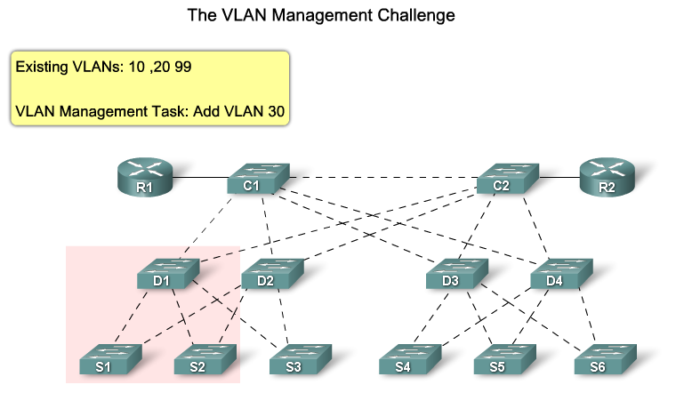
VLAN Trunking Protocol (VTP)

Slide 4
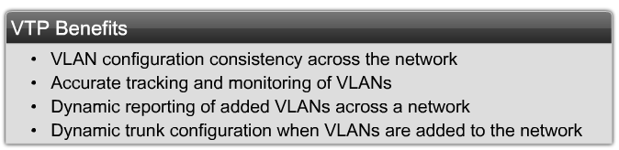
VLAN Trunking Protocol (VTP)

Slide 5
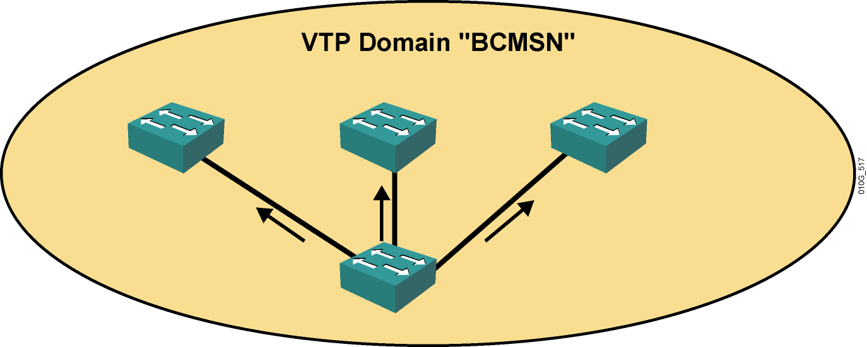
The VTP Domain
Group of switches that exchange VLAN information
VLANs administered centrally at a chosen switch

Slide 6
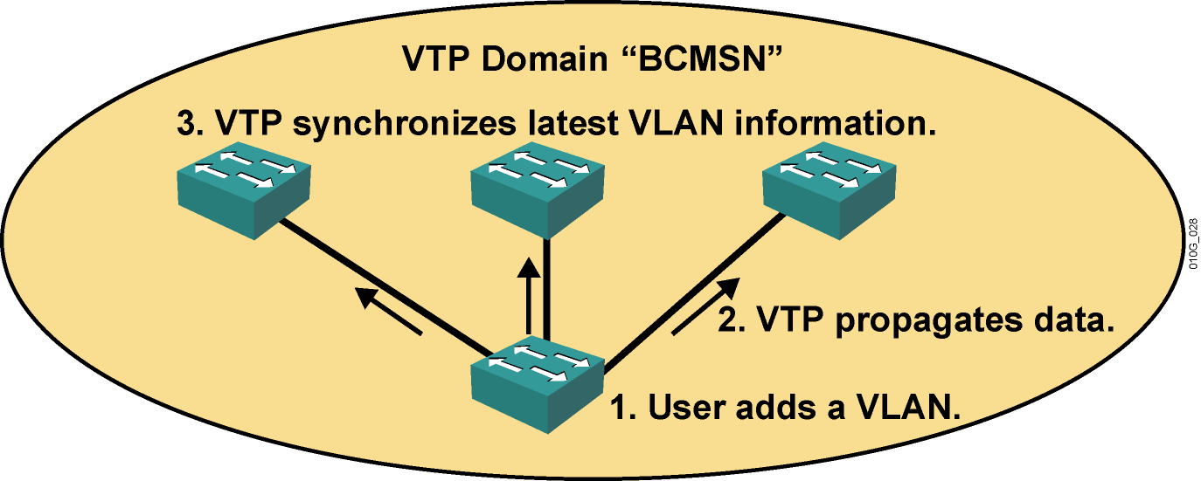
The VTP Protocol
  Advertises VLAN configuration information
  Maintains VLAN configuration consistency throughout a common administrative domain
  Sends advertisements on trunk ports only

Slide 7
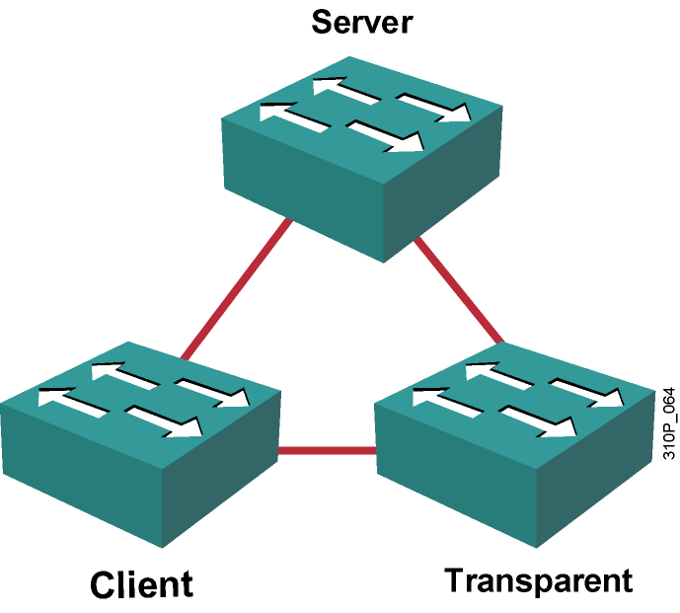
VTP Modes
  Server (default mode)
  Creates, modifies, and deletes VLANs
  Sends and forwards advertisements
  Synchronizes VLAN configurations
  Saves configuration in NVRAM
  Client
  Cannot create, change,
  or delete VLANs
  Forwards advertisements
  Synchronizes VLAN configurations
  Does not save in
  NVRAM
  Transparent
  Creates, modifies, and deletes local VLANs
  Forwards advertisements
  Does not synchronize VLAN configurations
  Saves configuration in NVRAM

Slide 8
VTP Configuration Commands
Configuring VTP
  Switch(config)# vtp domain name
  Switch(config)# vtp mode mode
  Switch(config)# vtp password password
Verifying VTP
  show vtp status
  show vtp counters

Slide 9
Verifying the VTP Configuration
Switch#show vtp status
Switch#show vtp status
VTP Version : 2
Configuration Revision : 28
Maximum VLANs supported locally : 1005
Number of existing VLANs : 17
VTP Operating Mode : Client
VTP Domain Name : BCMSN
VTP Pruning Mode : Enabled
VTP V2 Mode : Disabled
VTP Traps Generation : Disabled
MD5 digest : 0x45 0x52 0xB6 0xFD 0x63 0xC8 0x49 0x80
Configuration last modified by 10.1.1.1 at 8-12-05 15:04:49
Switch#

Slide 10
Take care of revision number

Slide 11
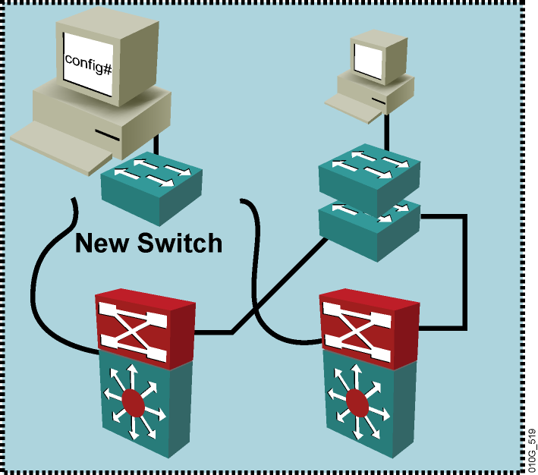
Adding a Switch to an Existing VTP Domain
Ensure a new switch has VTP revision 0 before adding it to a network by converting its mode to transparent .

